Slide 1

ECS 351L and 851L: Geospatial Data Science
Lecture 2: Vector data analysis
Email: jonathan.ryan@duke.edu
Office: 3101 Grainger Hall
Office hours: Mondays and Wednesdays 15:00-16:00

Slide 2
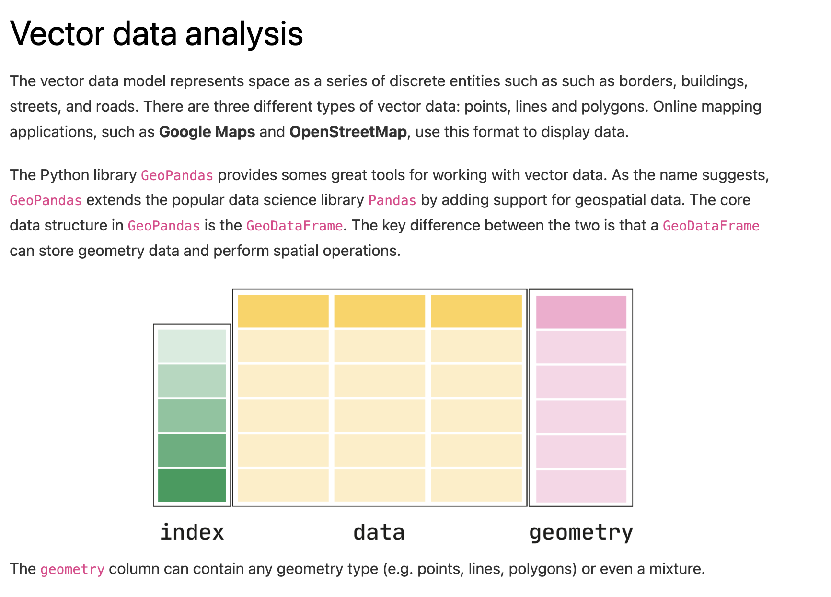
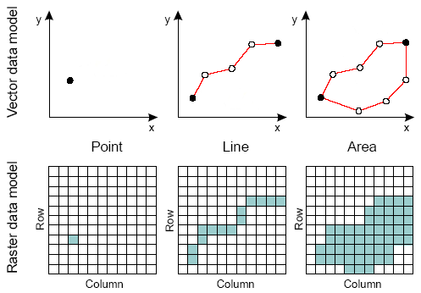

Slide 5
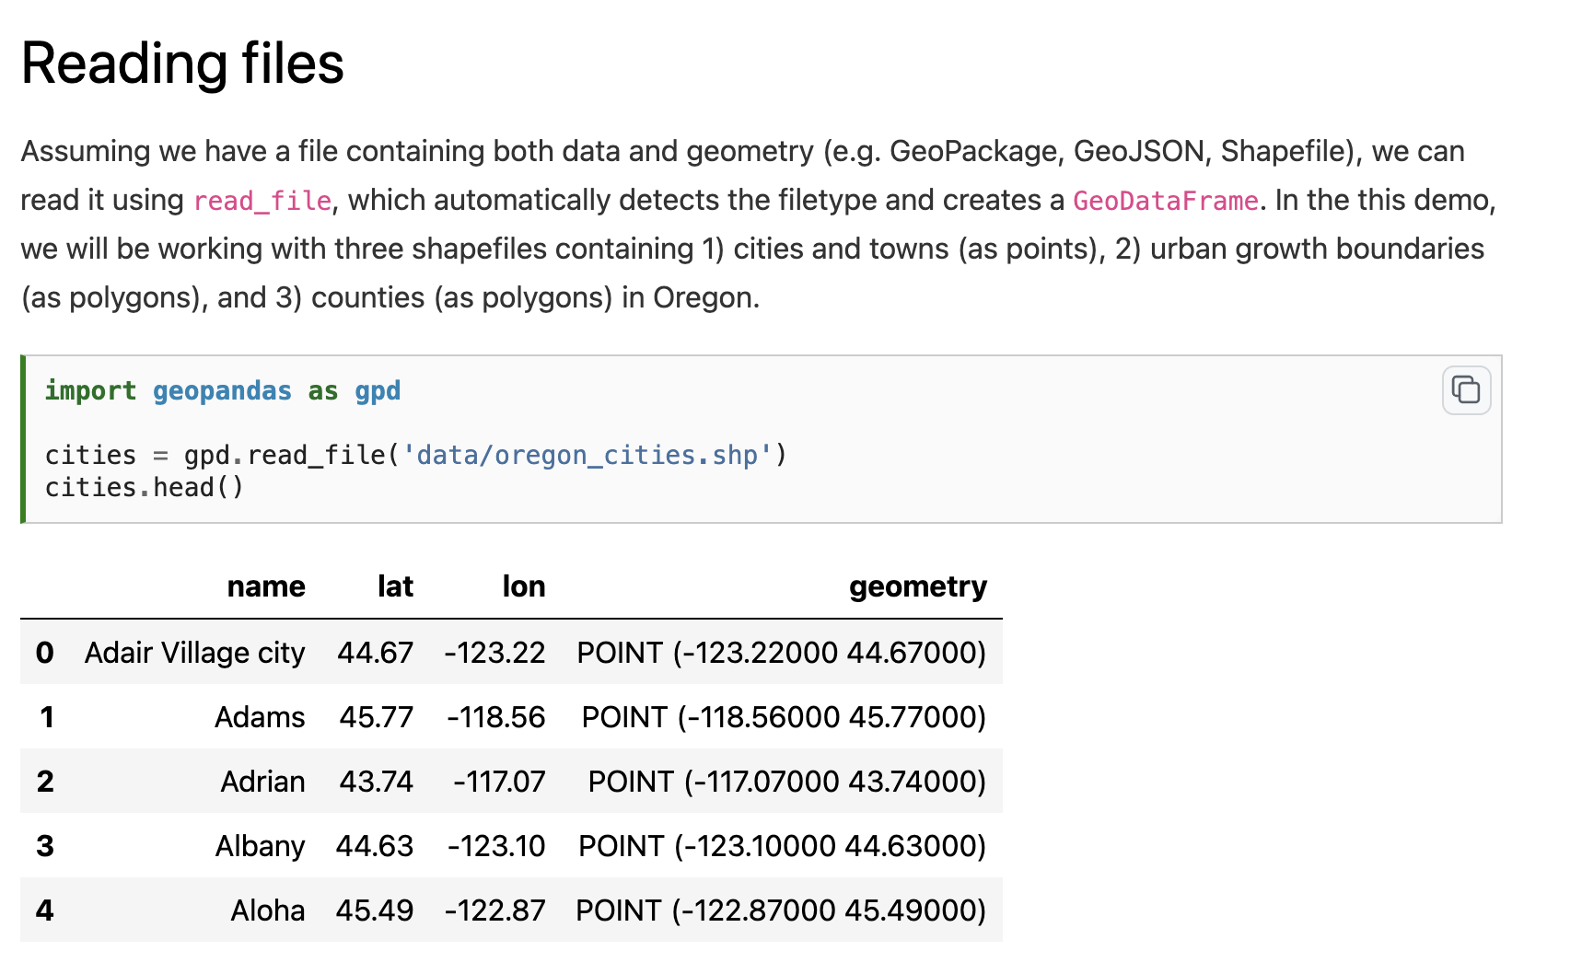

Slide 7
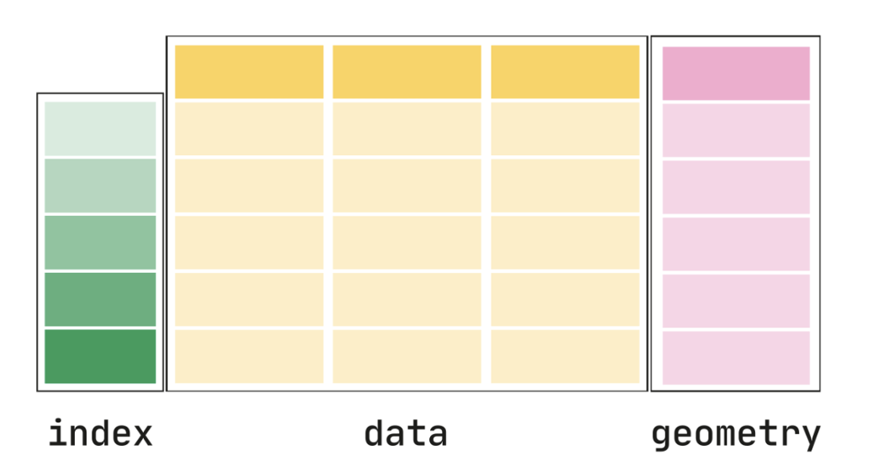

Slide 8
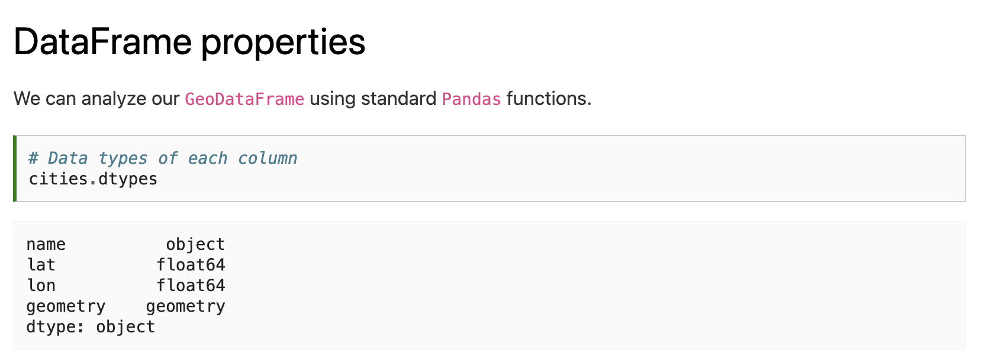
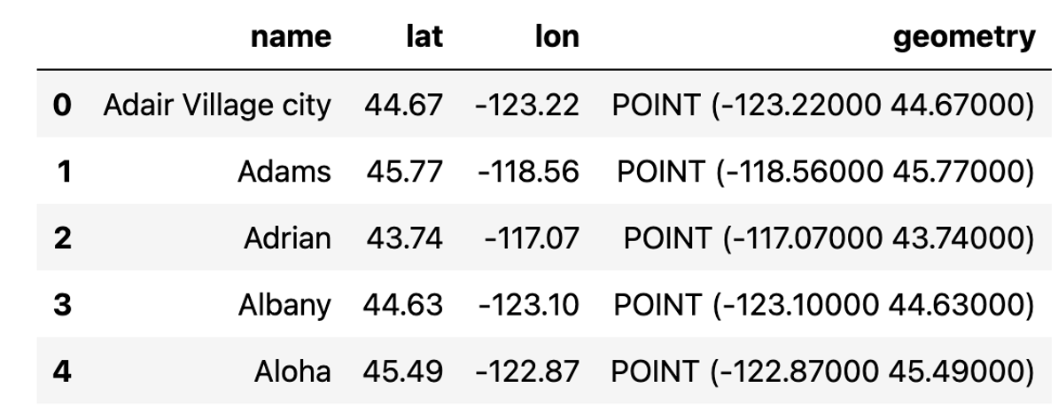

Slide 9
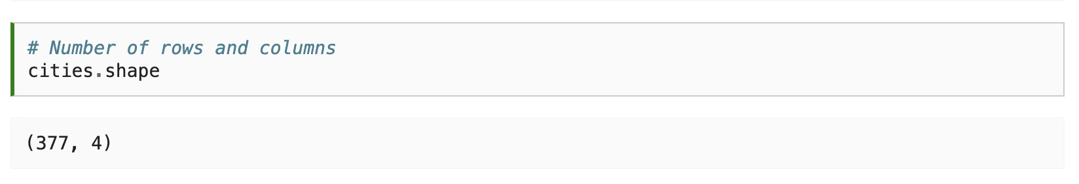

Slide 10
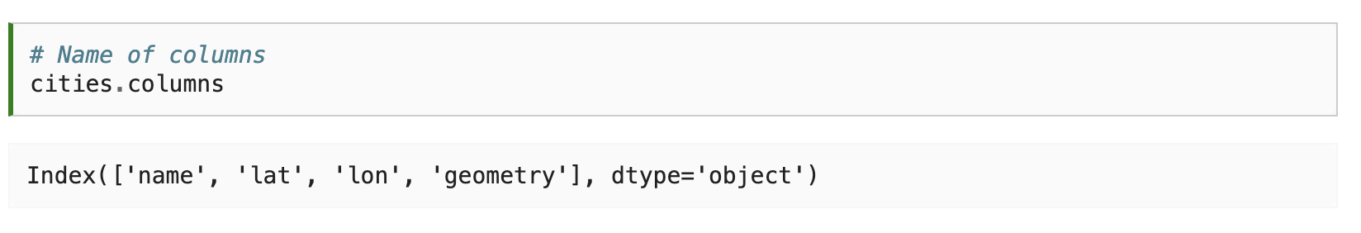

Slide 11
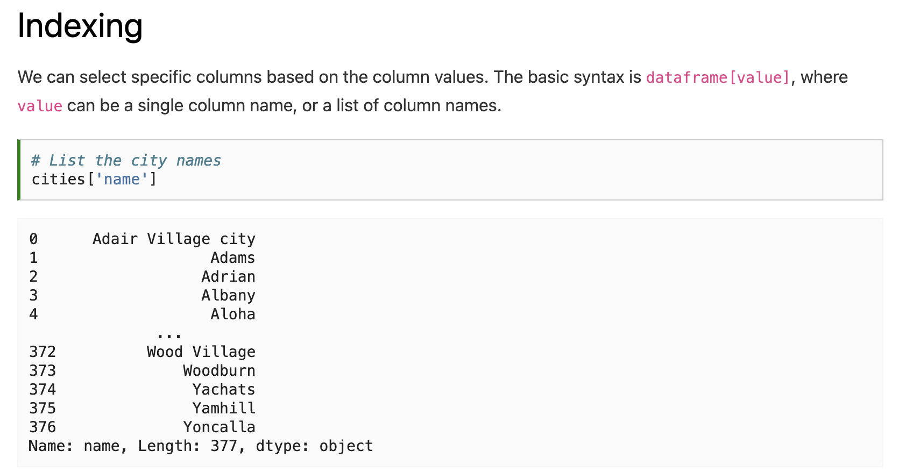

Slide 12
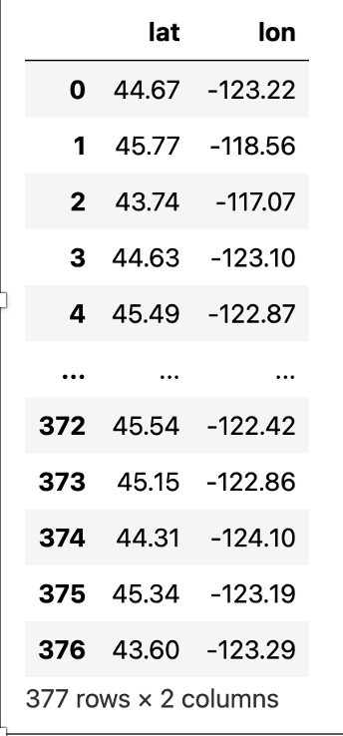
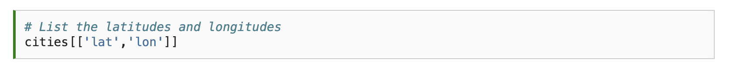

Slide 13
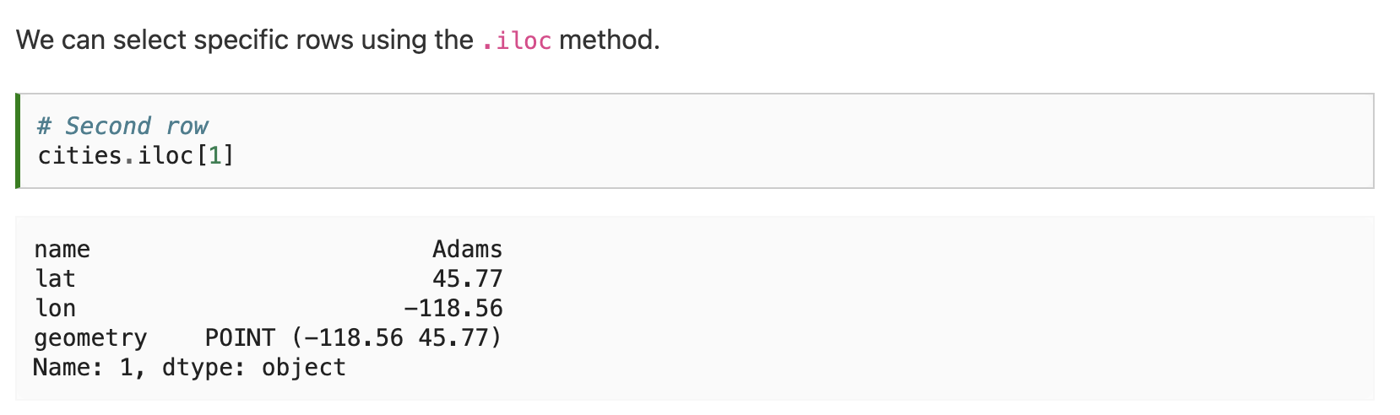

Slide 14
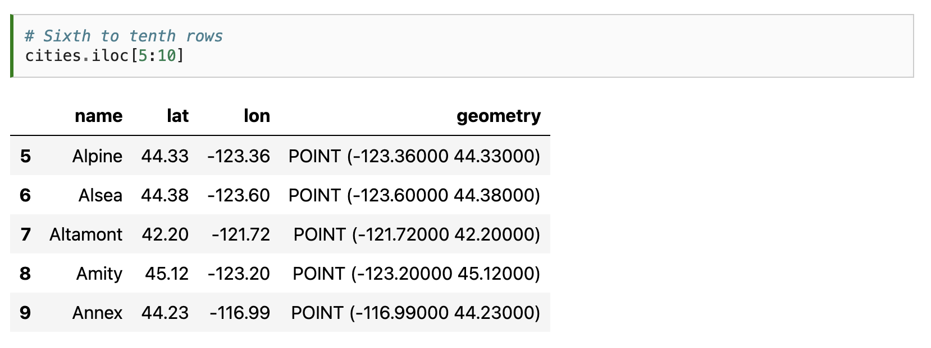

Slide 15
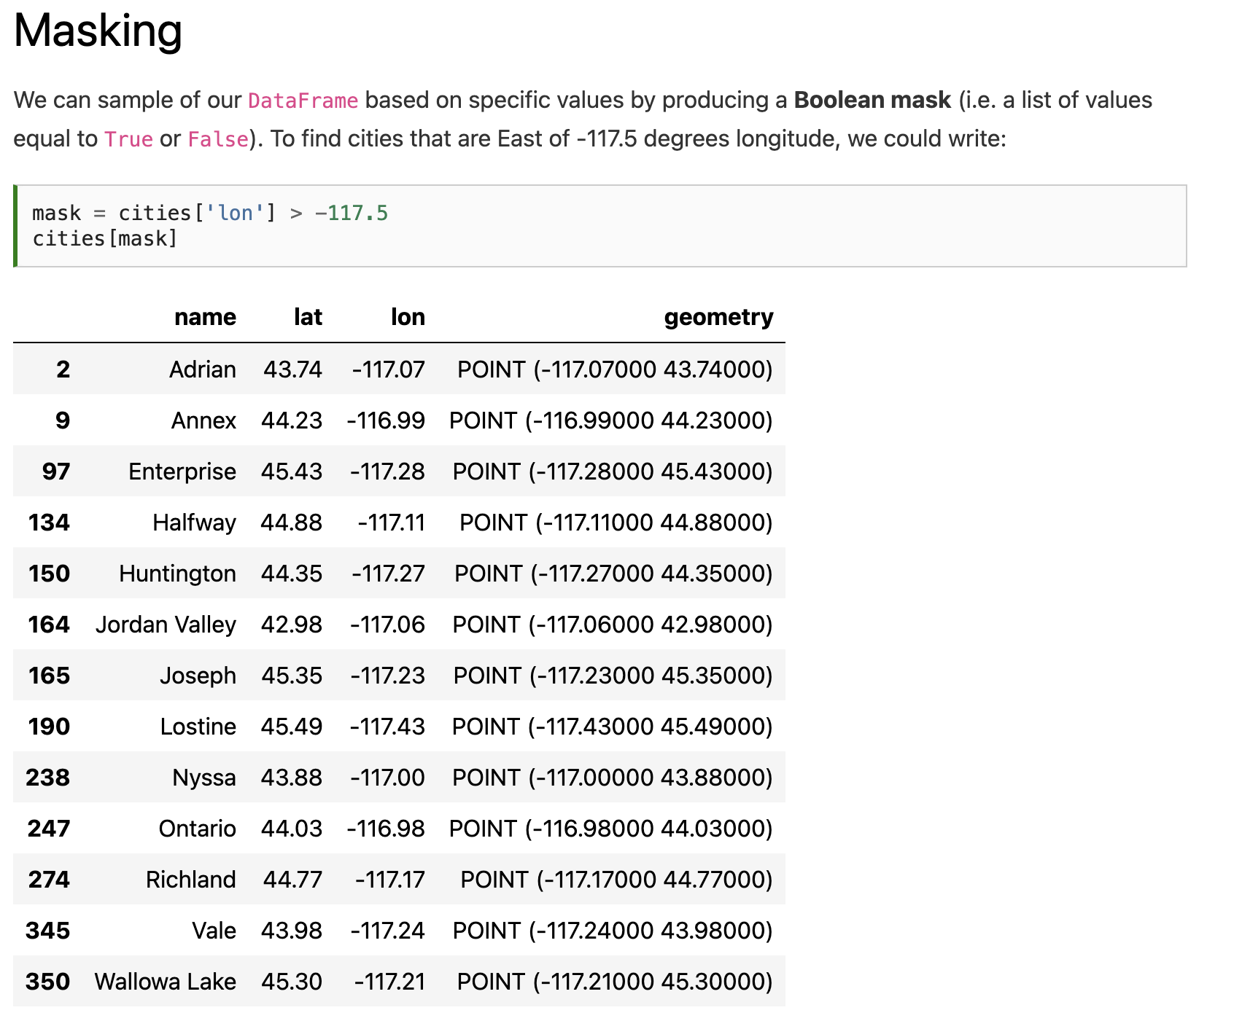

Slide 17
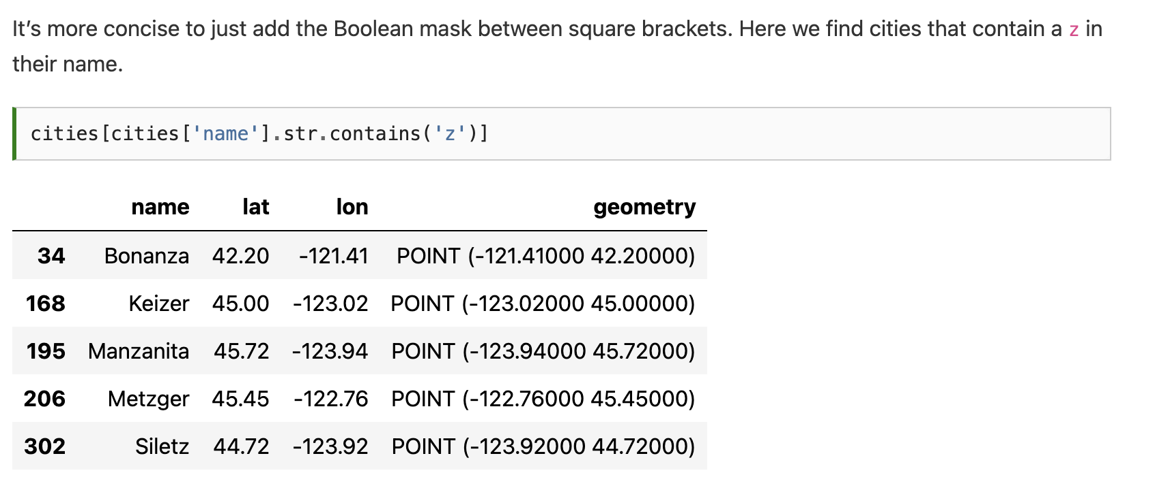

Slide 18
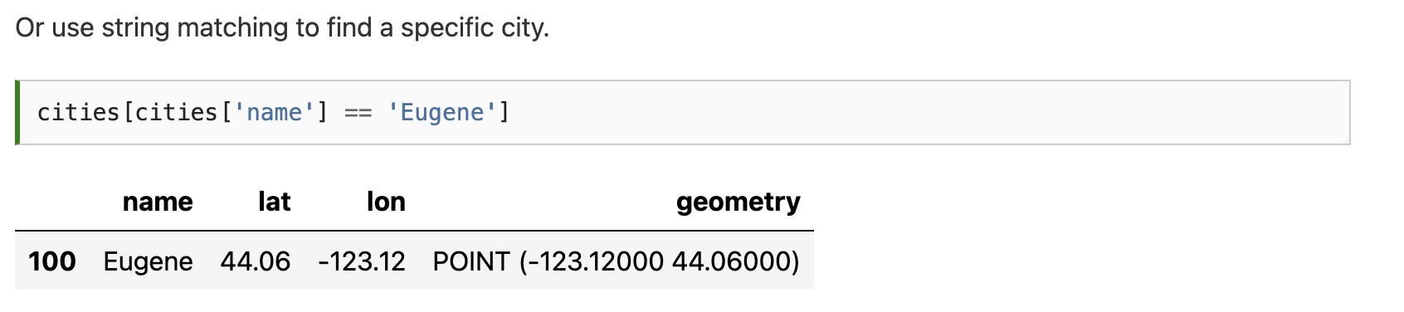

Slide 19
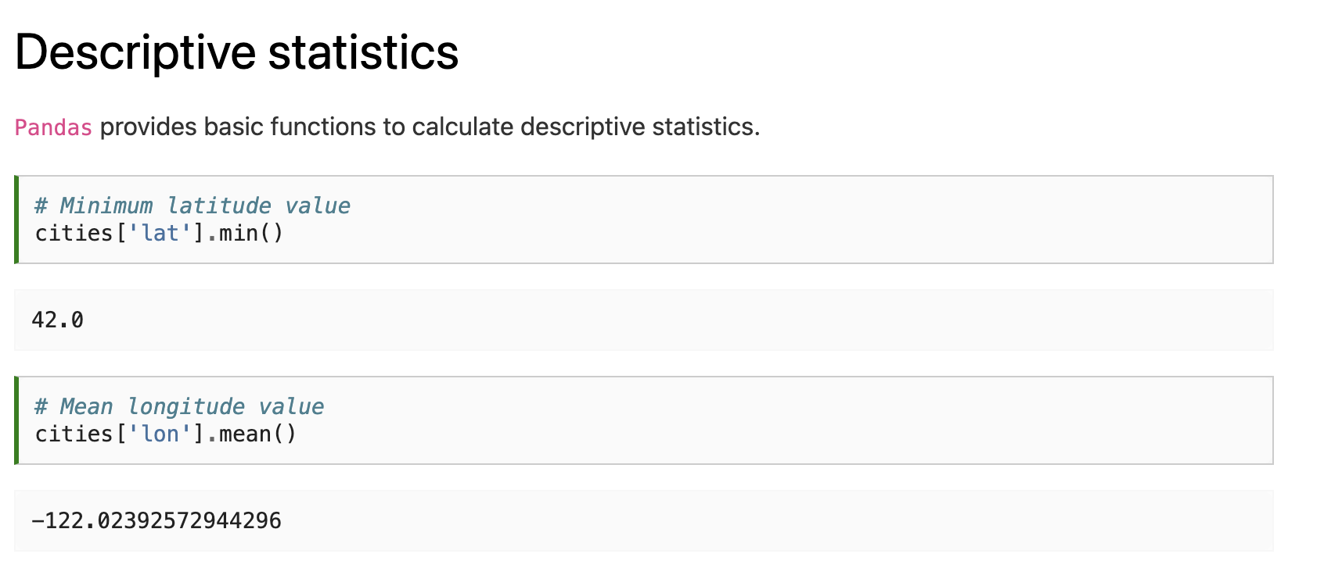

Slide 21
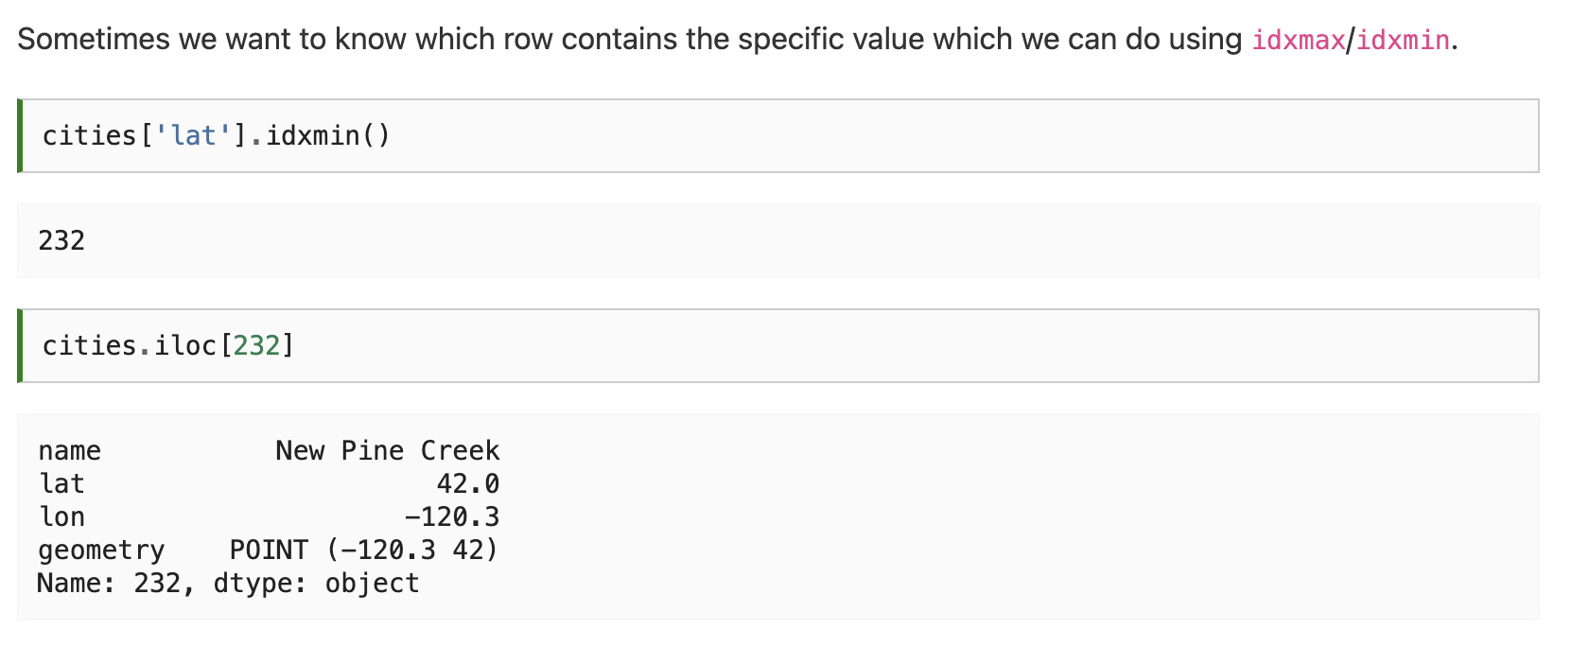

Slide 23
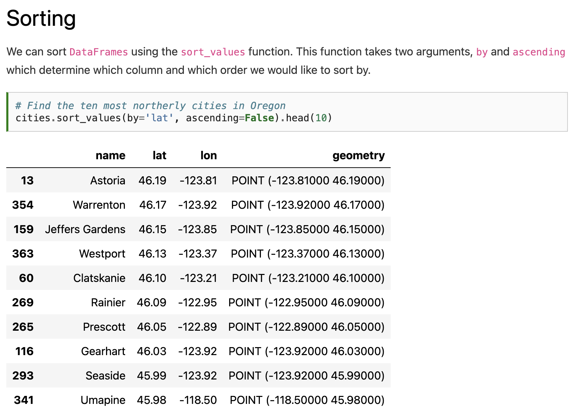

Slide 25
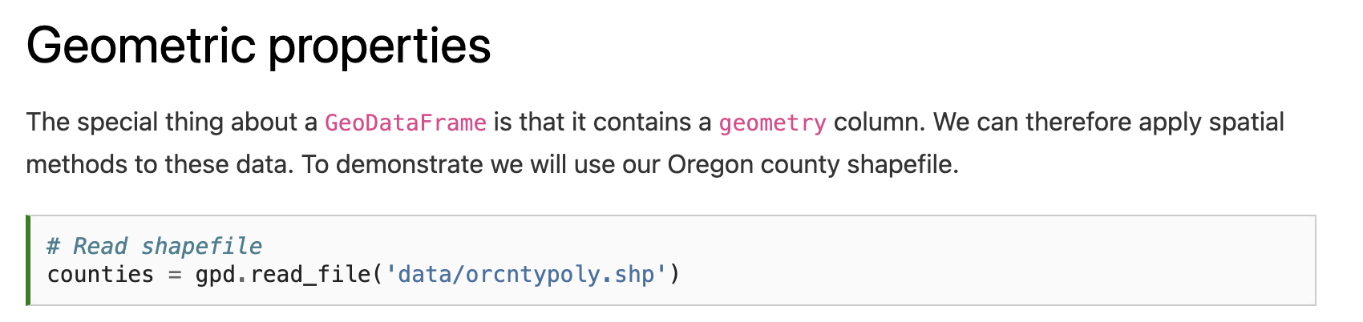
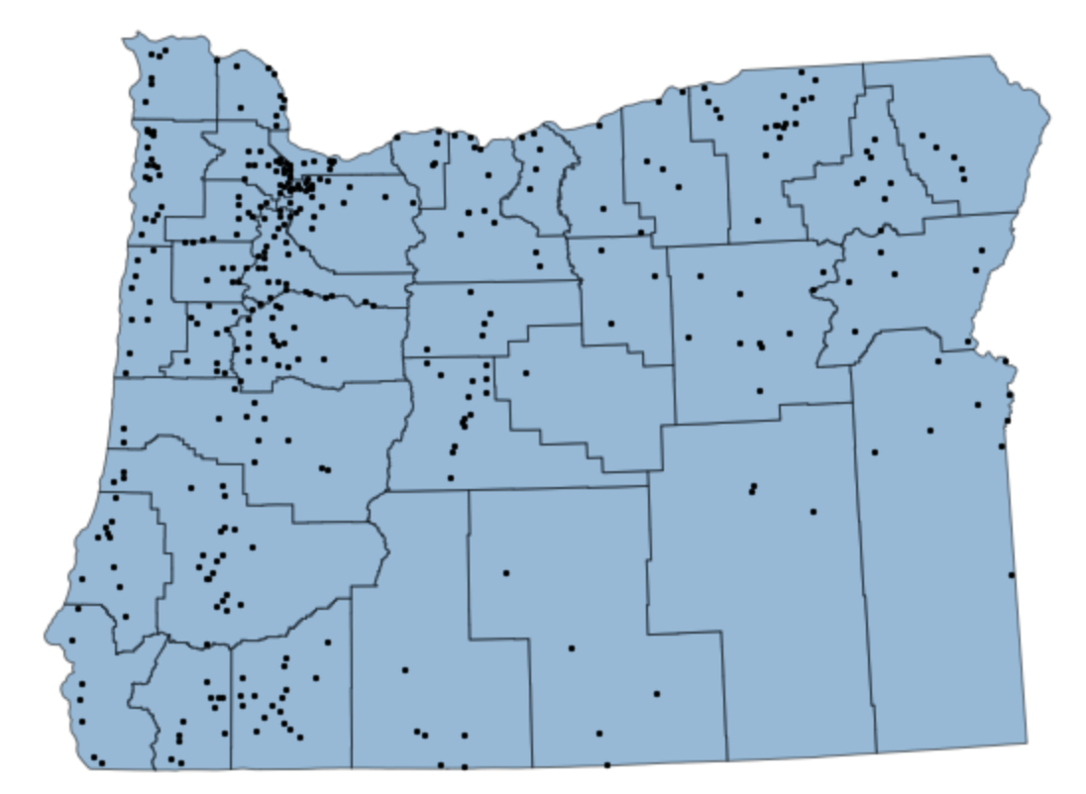

Slide 26
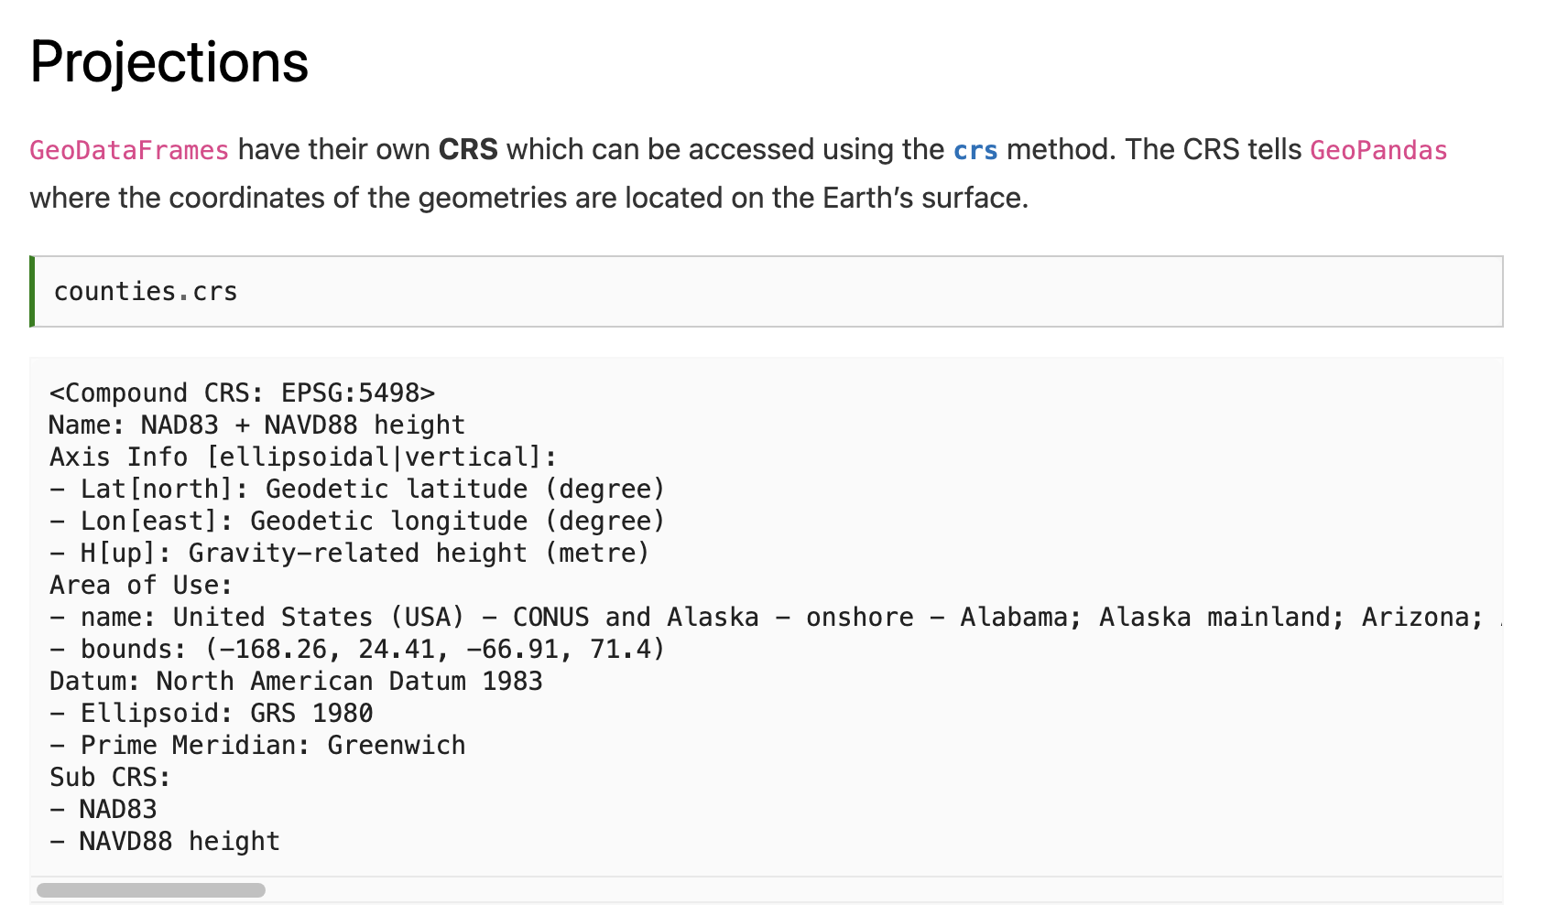

Slide 28
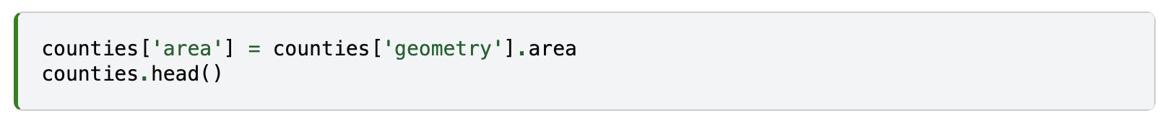
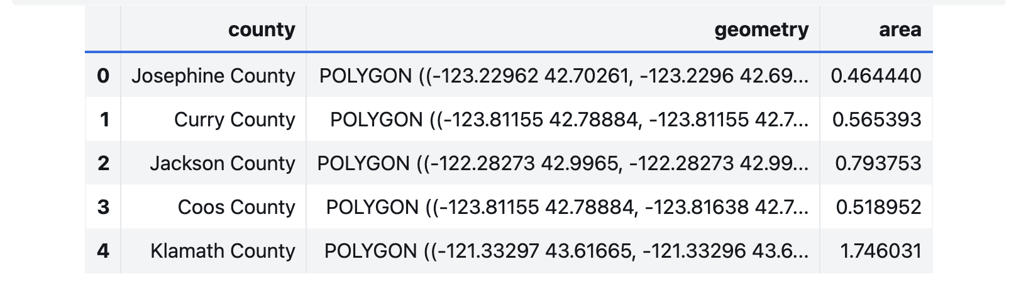

Slide 29
UserWarning: Geometry is in a geographic CRS. Results from 'area' are likely incorrect. Use 'GeoSeries.to_crs()' to re-project geometries to a projected CRS before this operation.
Notes:
Warning because latitude and longitude are angular measures, not linear. At the equator, 1° longitude ≈ 111 km. Near the poles, 1° longitude ≈ 0 km (because meridians converge).

Slide 30
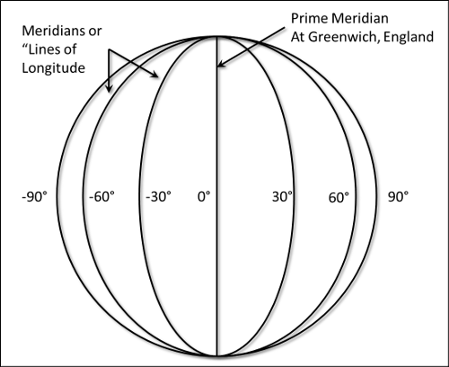
UserWarning: Geometry is in a geographic CRS. Results from 'area' are likely incorrect. Use 'GeoSeries.to_crs()' to re-project geometries to a projected CRS before this operation.
Notes:
Warning because latitude and longitude are angular measures, not linear. At the equator, 1° longitude ≈ 111 km. Near the poles, 1° longitude ≈ 0 km (because meridians converge). For example, a 1° by 1° box at the equator covers ~12,300 km², while near the poles it covers close to zero.

Slide 31
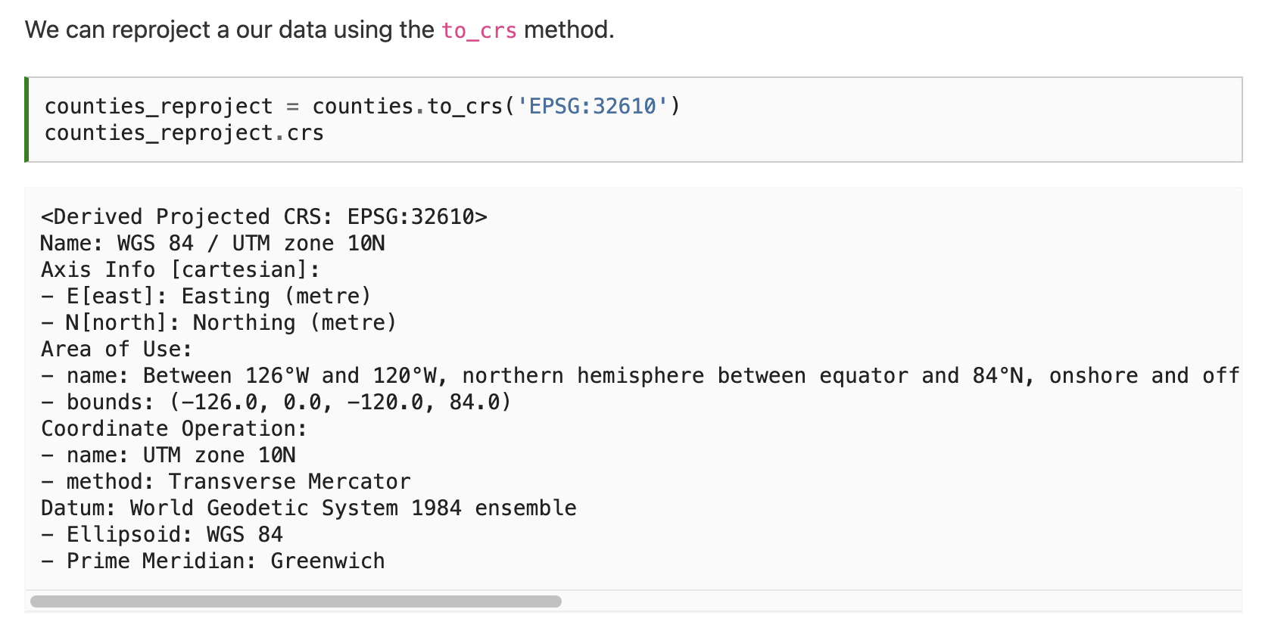

Slide 32
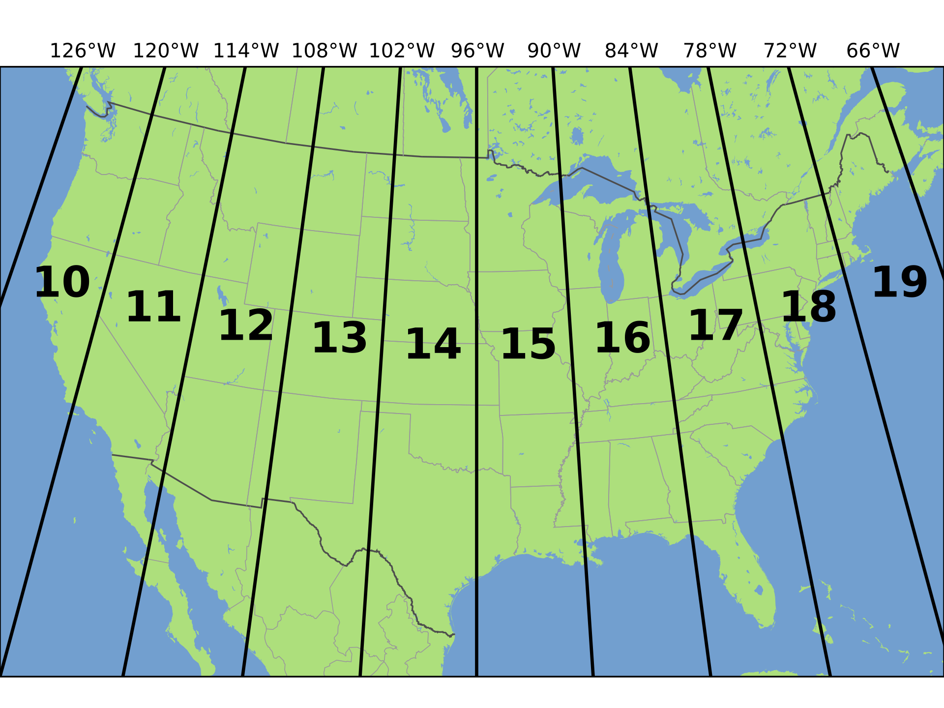
Notes:
For county level research – UTM is a good choice. Divides the Earth into 60 zones, each 6° of longitude in width. So long as we are in the right zone, distortions should be minimal.

Slide 33
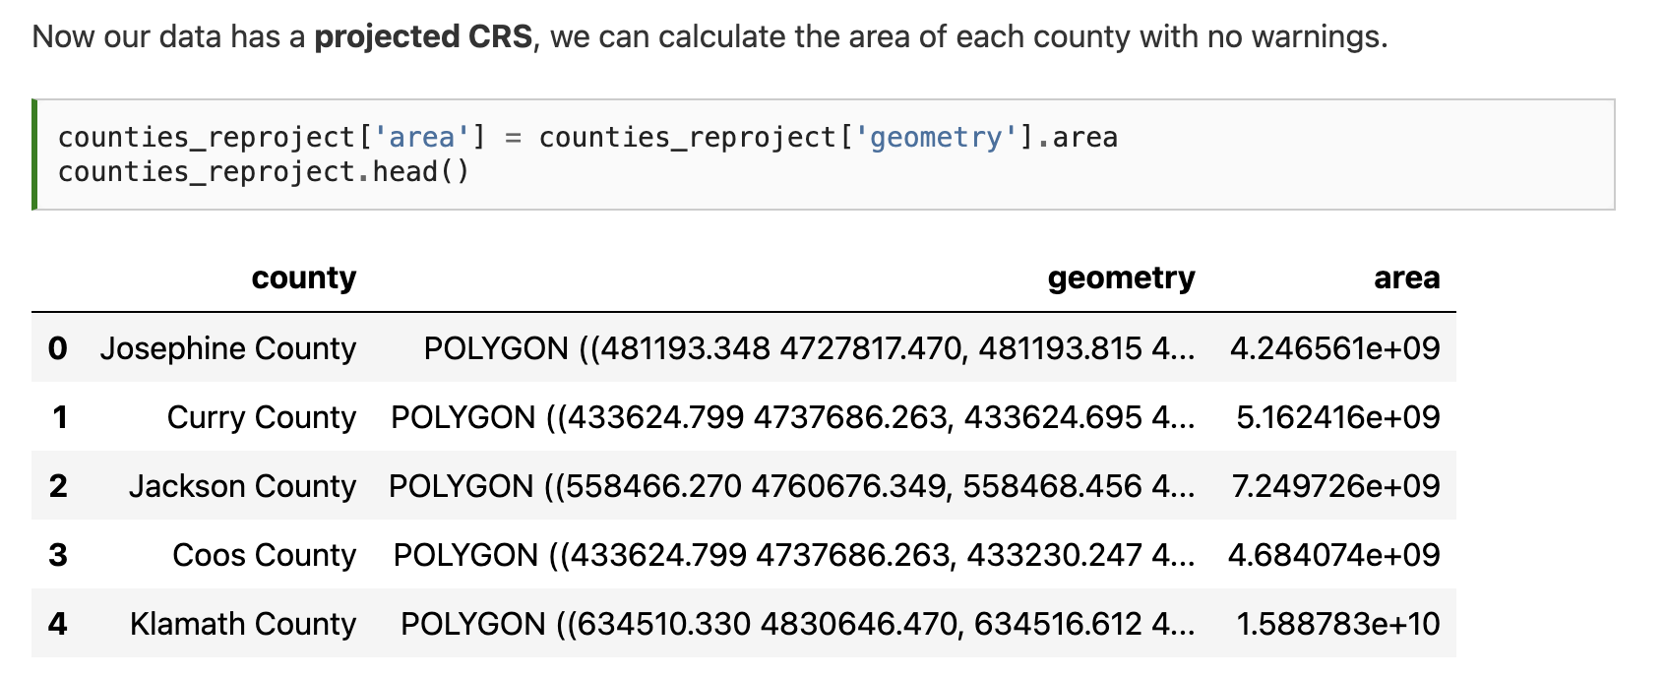

Slide 34
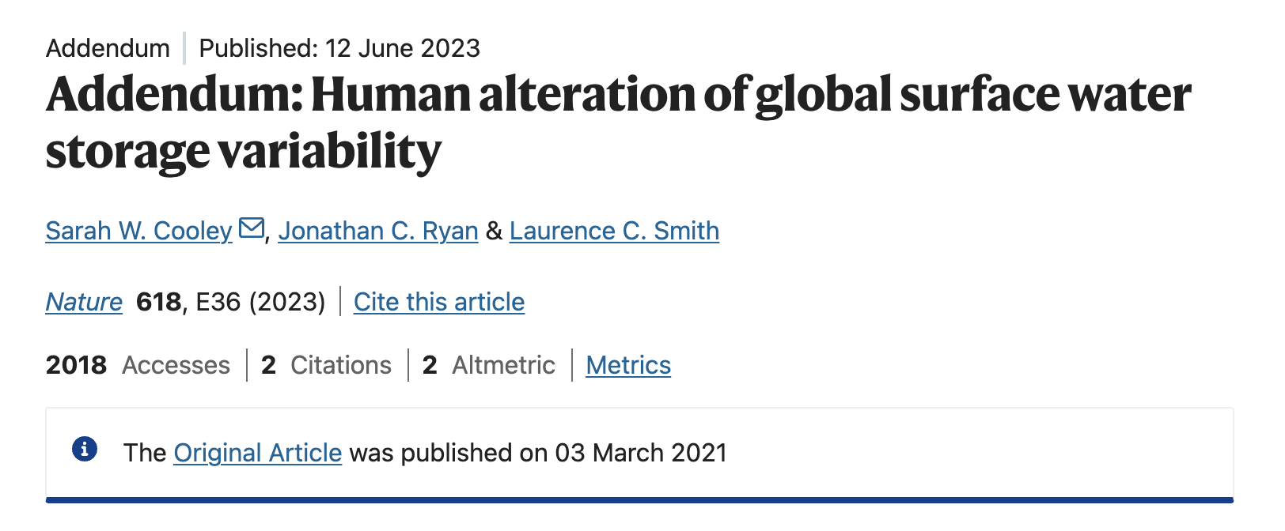
Notes:
We used a global water product derived from Landsat – assuming the grid cell size was 30 m (i.e. Landsat). But it was actually 0.00025° × 0.00025° which means the grid cells were small at higher latitudes than at the equator. Caused us to overestimate area of water particularly at high latitudes. Subsequently corrected and now the numbers are right. “Assumptions are the mother of all f-ups!”

Slide 35
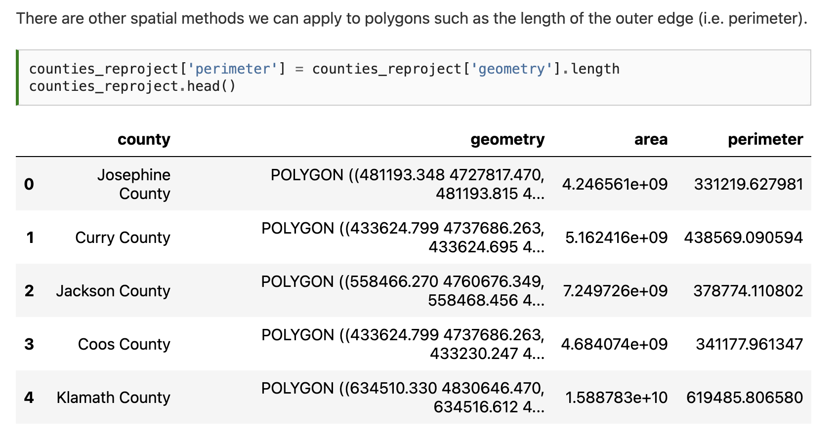

Slide 36
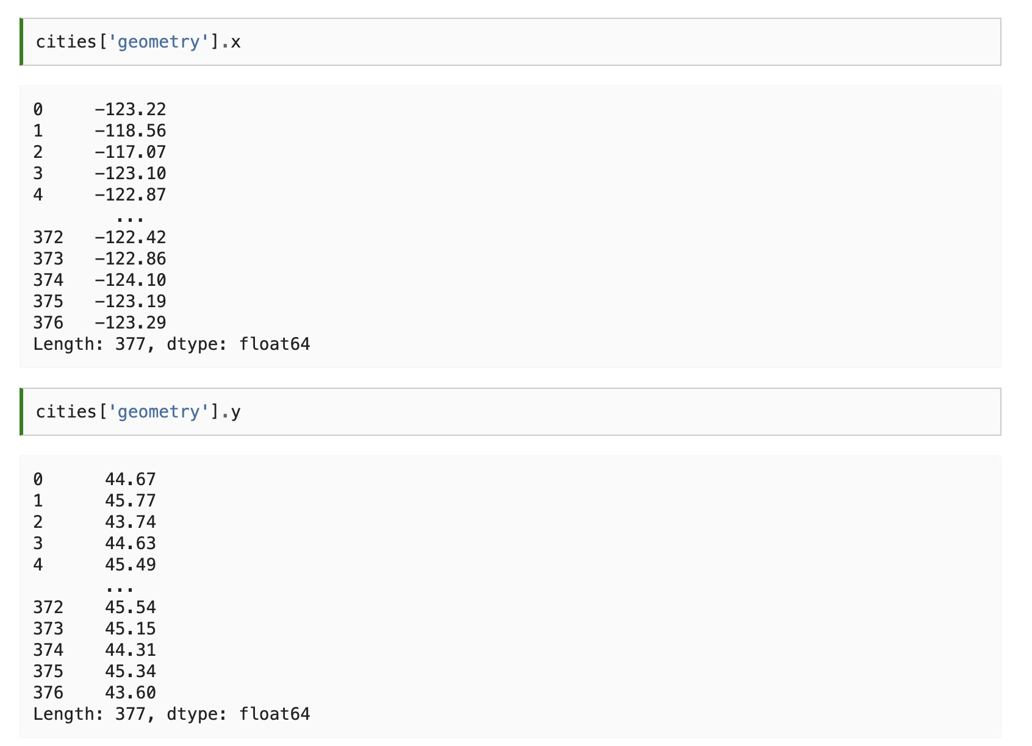

Slide 37
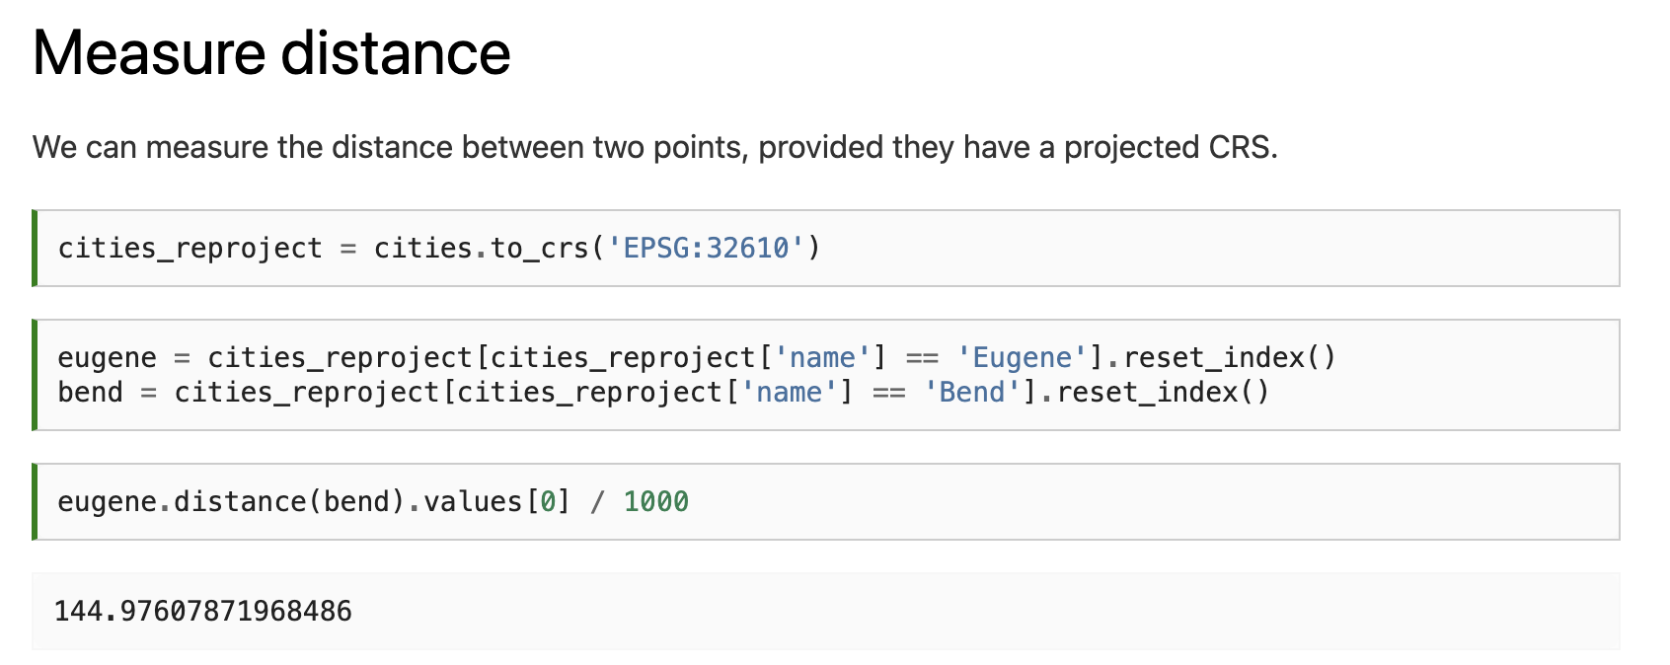

Slide 40
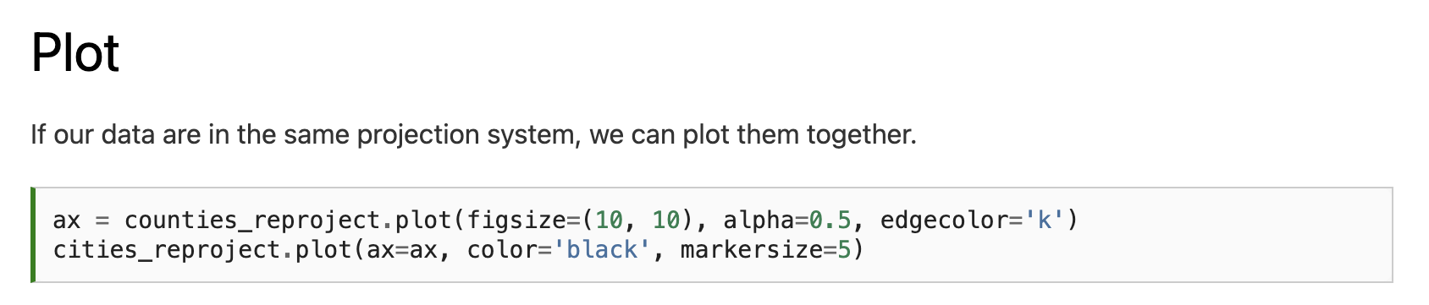
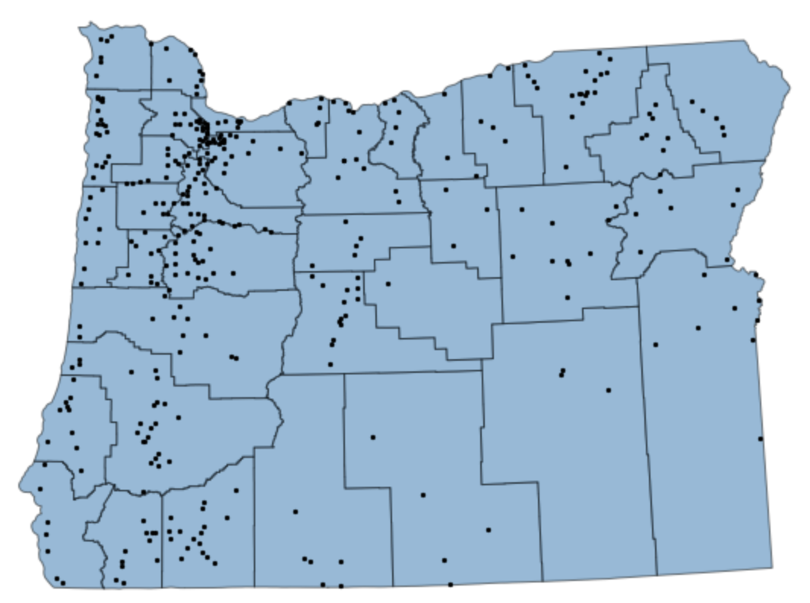

Slide 41
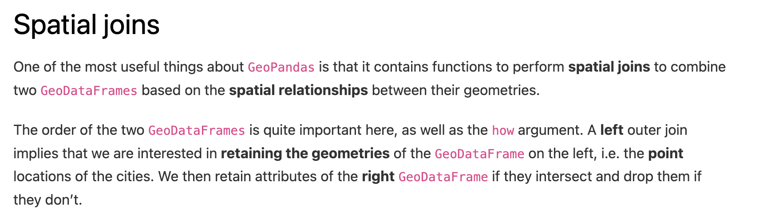

Slide 42
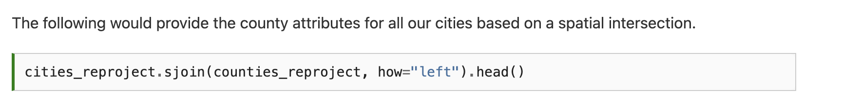
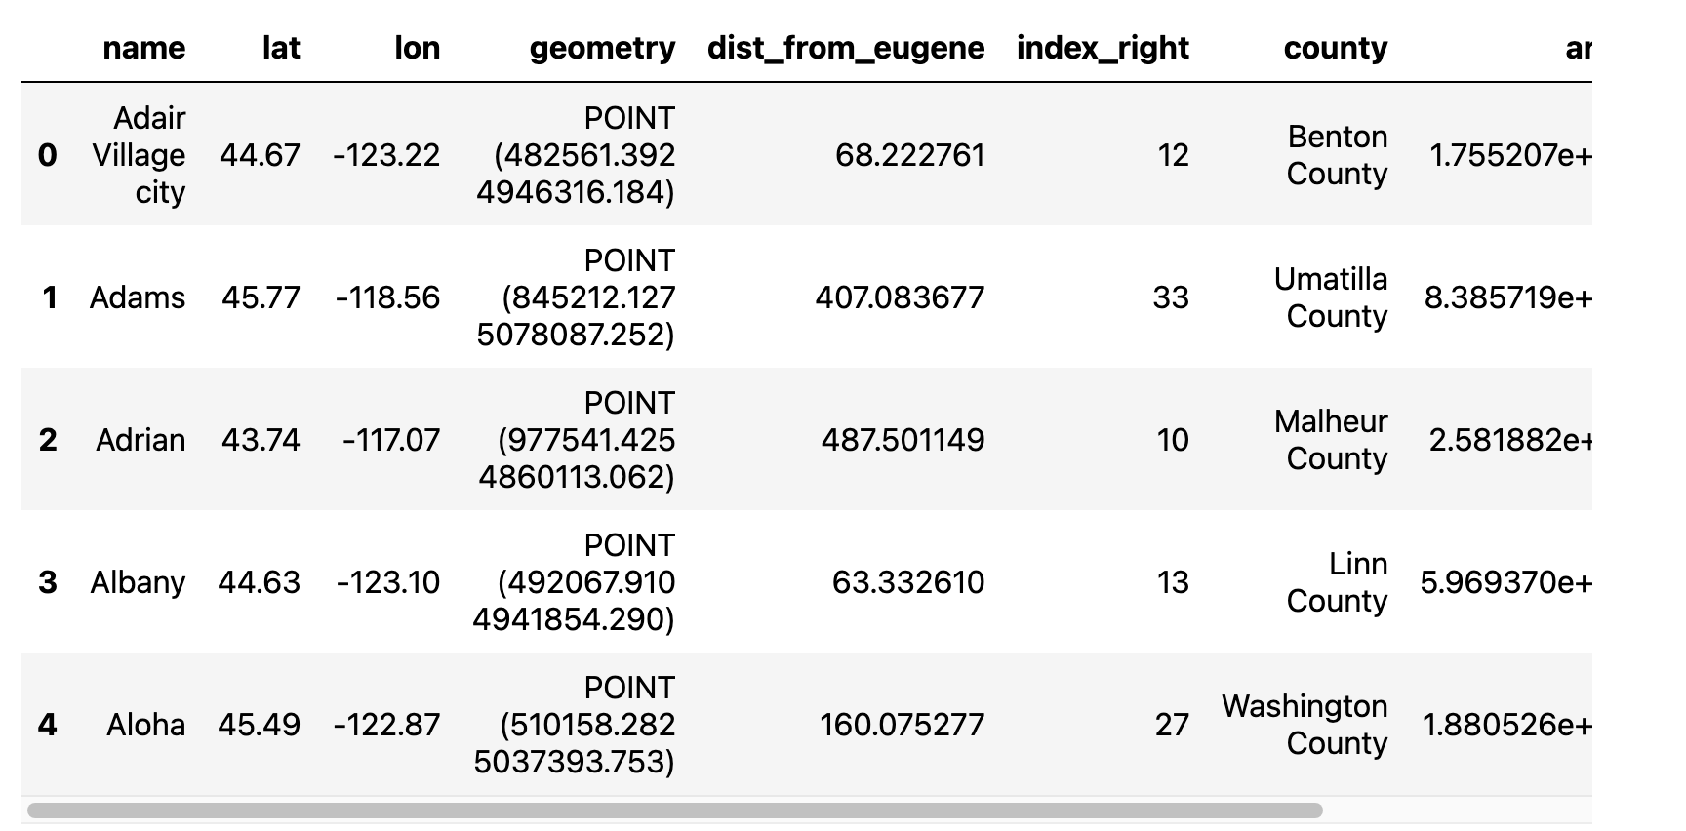

Slide 43
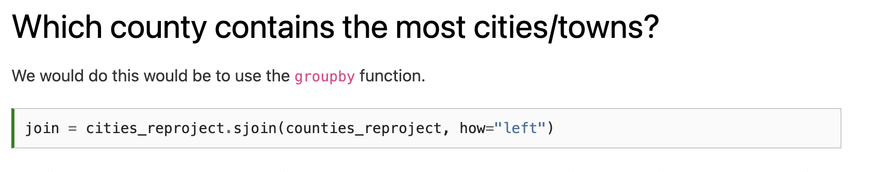

Slide 44
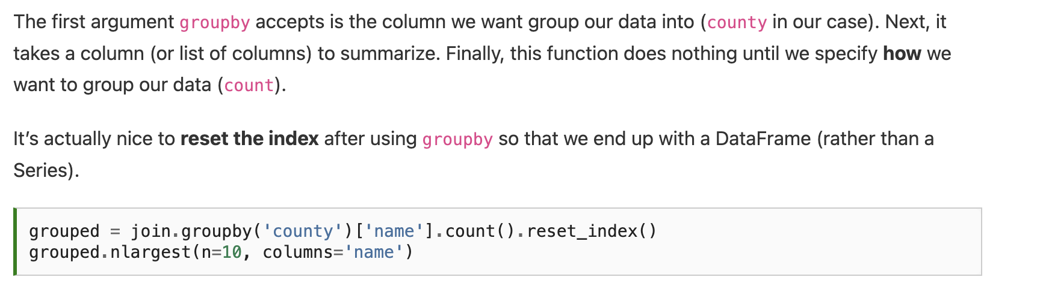
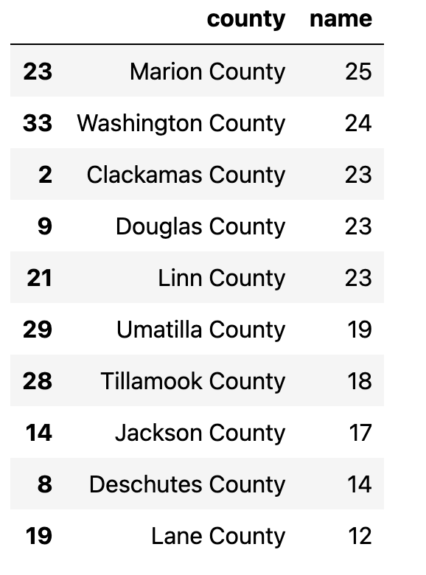

Slide 45
Homework
Assignment 1 due Wednesday Sep 3, 11:59pm

Slide 46
Next time (Wednesday): Activity 1
Email: jonathan.ryan@duke.edu
Office: 3101 Grainger Hall
Office hours: Mondays and Wednesdays 15:00-16:00

